Slide 1
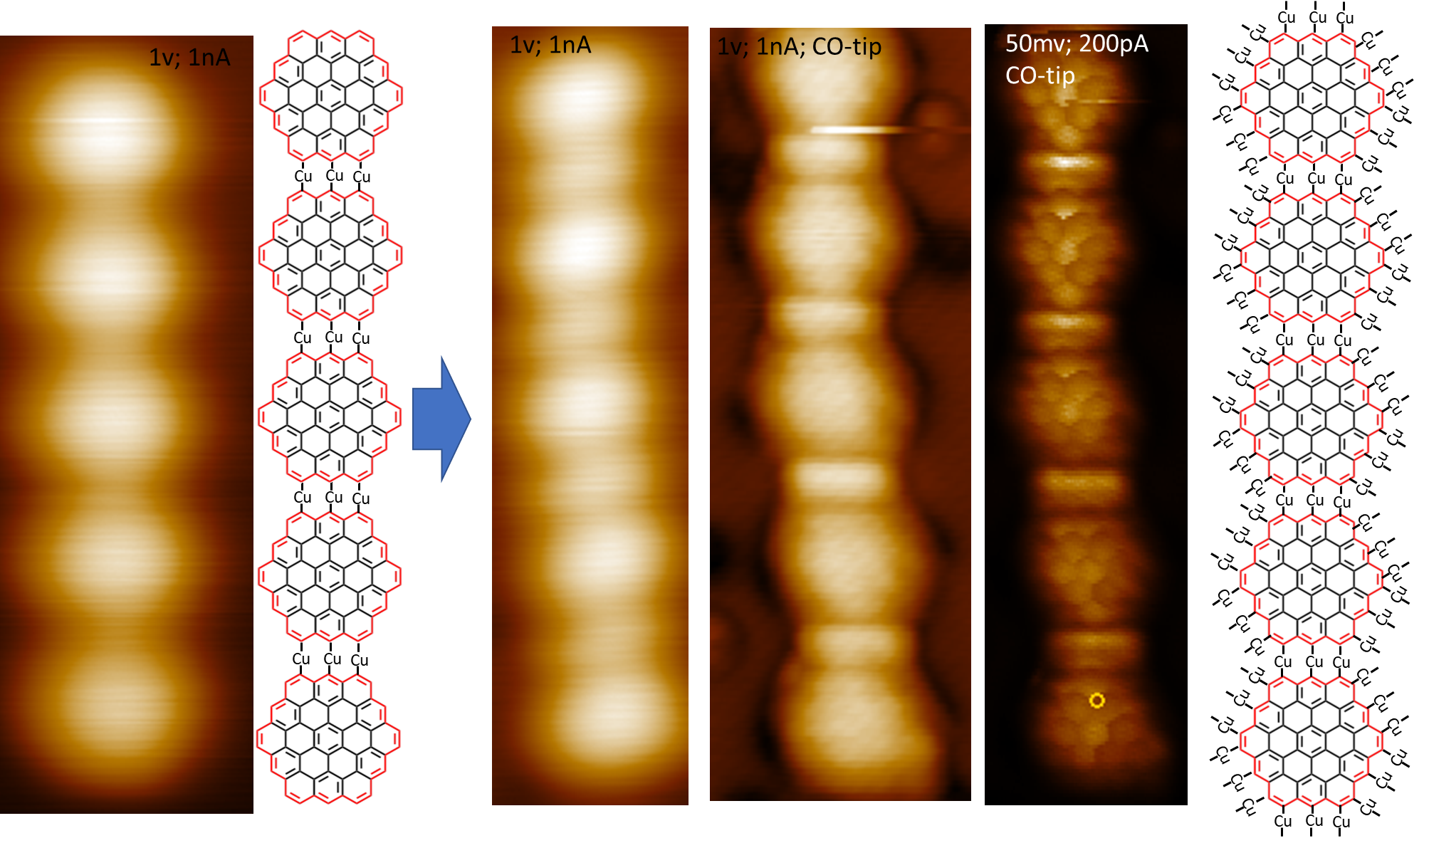
Notes:
Jul 11, 2024 email.

Slide 2
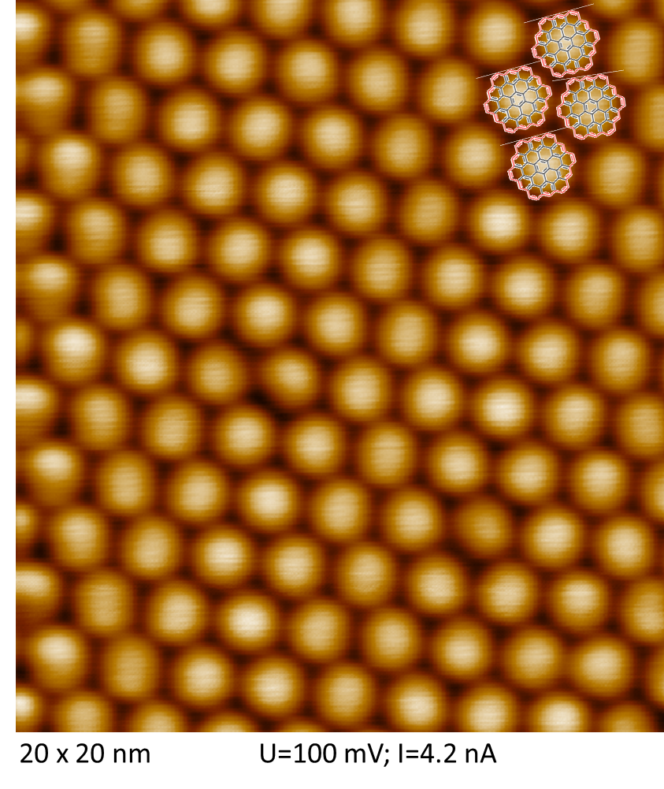
Cu(111) surface
Notes:
Jul 18, 2024 email.
Q (JH): Is this STM image acquired after converting the precursor to circumcoronene (the third molecule on the next slide after 140C) or after 260C treatment?

Slide 3
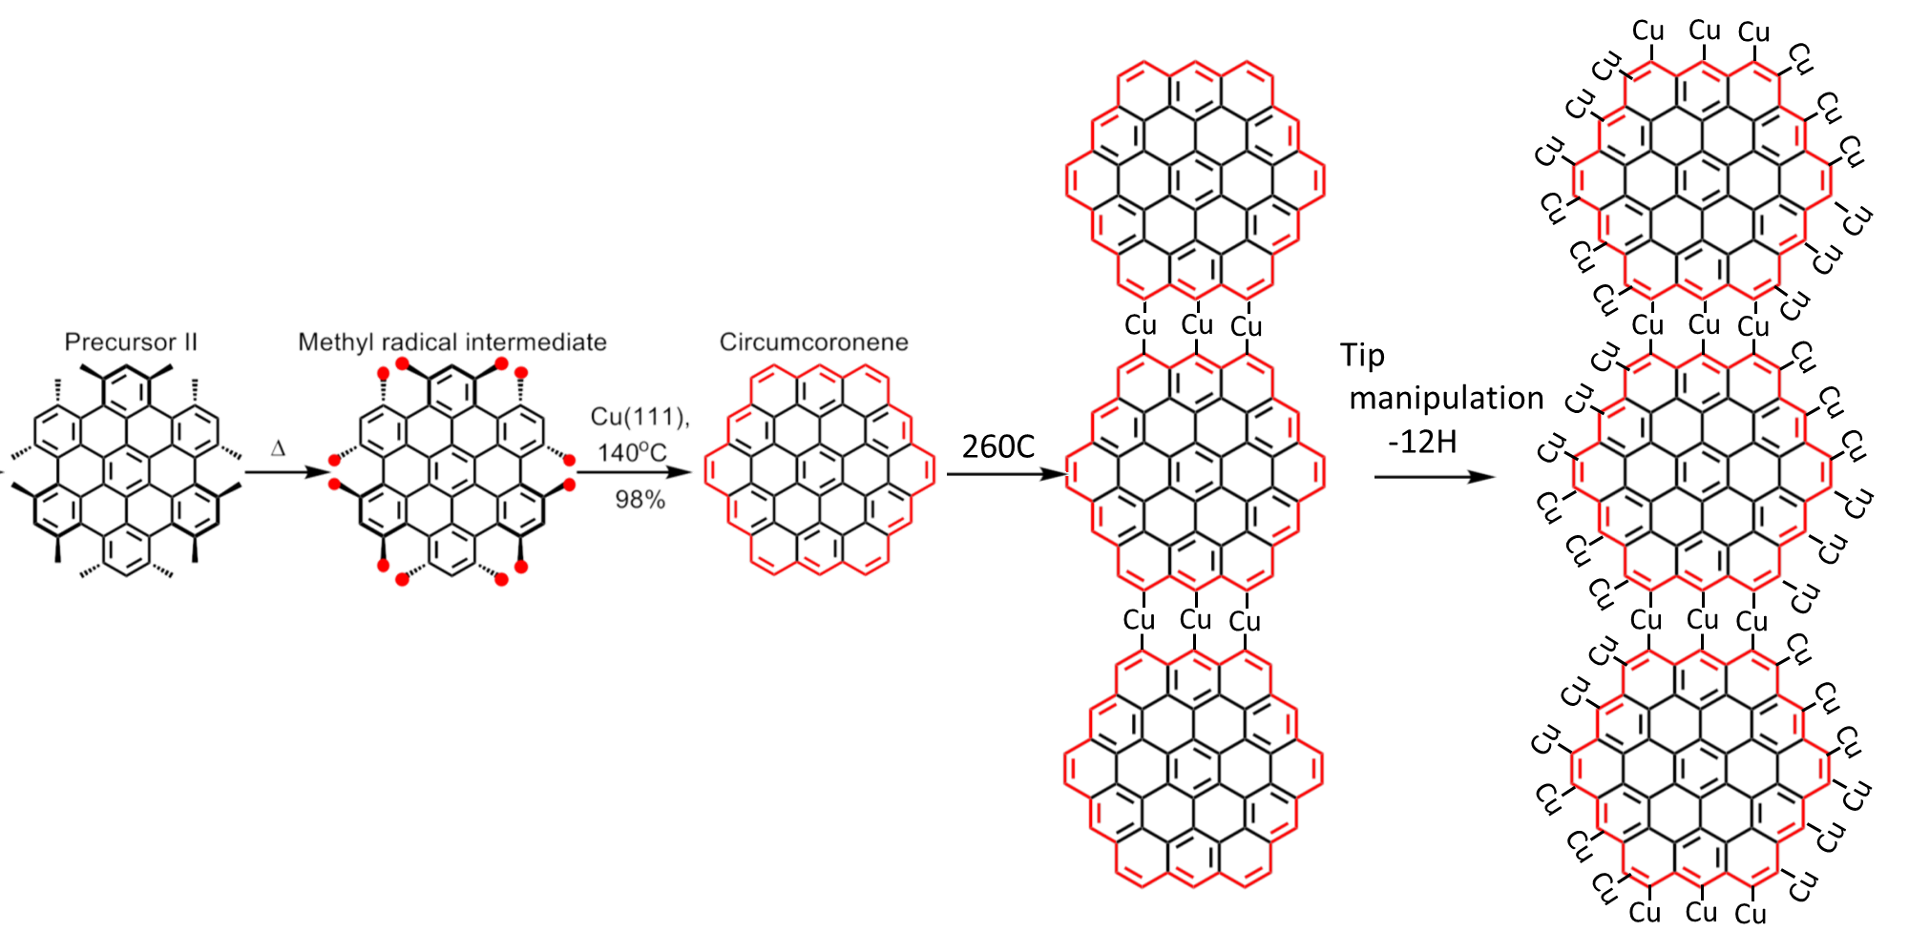
Notes:
Jul 18, 2024 email.
The proposed mechanism makes sense:
1) The precursor molecule is non-planar due to steric repulsions between neighboring methyl groups;
2) Each methyl loses one H giving primary benzylic radical, which is stabilized by resonance effect (see https://kpu.pressbooks.pub/organicchemistry/chapter/9-3-stability-of-carbon-radicals/);
3) neighboring R-CH2(dot) radicals couple together to form C-C single bond; the CH2-CH2 fragment loses two more H atoms giving CH=CH double bond, making the circumcoronene intermediate largely planar;
(signals of H/H2 may be detected following steps 2 and 3 as Chuanxu did using in-situ MS)
4) at 260C, the circumcoronene intermediates diffuse on the surface to undergo self-assembly forming 1D chain;
5) by tip manipulation, some edge H’s are further lost; probably detectable by in-situ MS.
I think this is a well-defined project and we can do some calculations and simulate some STM images as theoretical support for experimental observations.
Q (WL): If the Cu atoms are between the molecules, the STM images near the edge should be brighter usually.
Q (JH): The edge atoms might bend down toward the surface Cu atoms. Perhaps that make the edge atoms less bright?

Slide 4
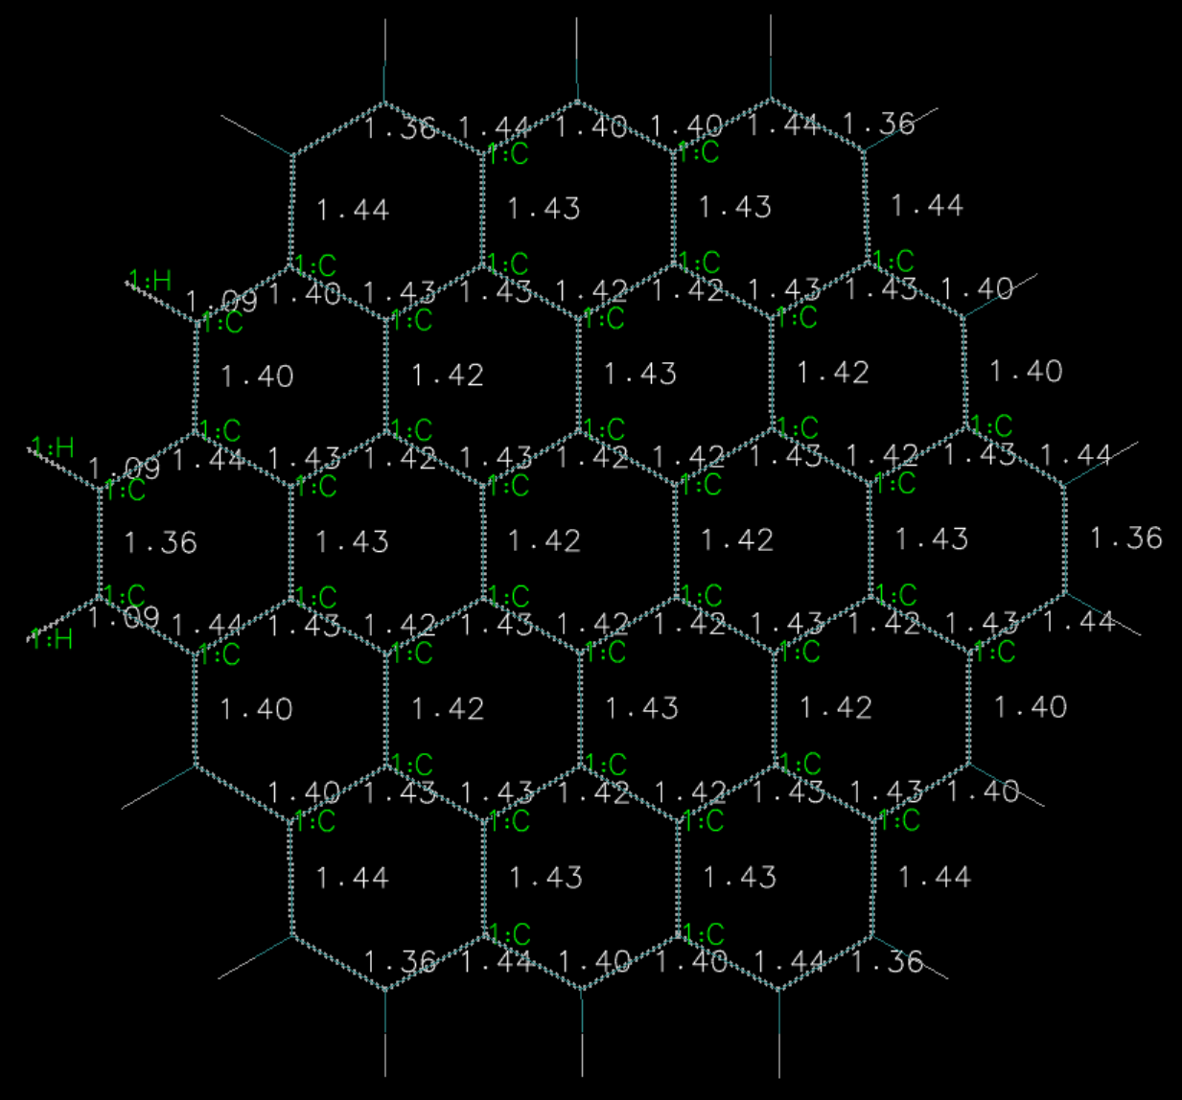

Slide 5
